Slide 1
Nadia J. Lalla, M.L.I.S.
Coordinator, Collections & Information Services
Taubman Health Sciences Library
The University of Michigan (Ann Arbor)
nadiamar@umich.edu
MDMLG Fall Meeting
20 September 2012
Royal Oak, Michigan

Slide 2
Mendeley
A Personal Library of References
Import & Organize PDFs, URLs, Citations
Read and Annotate PDFs
Insert Citations into Manuscripts
Share Papers and Annotations
Accessible on the Desktop, Web, iPad

Slide 3
What Is Mendeley?

Slide 4
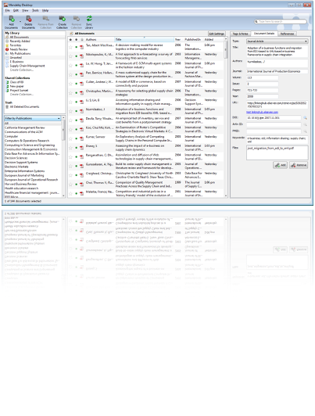
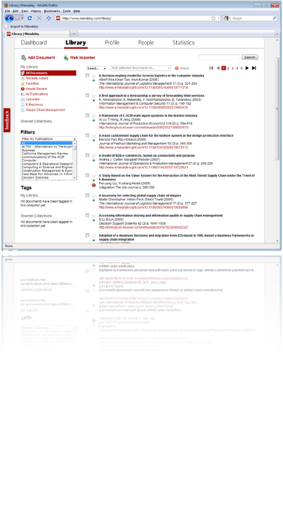
Mendeley Is …
… free software (Win, Mac & Linux) to manage, share, read, annotate, and cite research papers...
...and a research network to manage papers online, discover research trends and statistics, and to connect to like-minded researchers.

Slide 5
Developed by 30+ researchers, graduates, and software developers from …
...backed by co-founders and former executives of ...
... and supported by ...

Slide 6
Getting Started

Slide 7
Step #1 –
Create free account.
First Steps
Step #2 – Download to desktop/laptop.

Slide 8
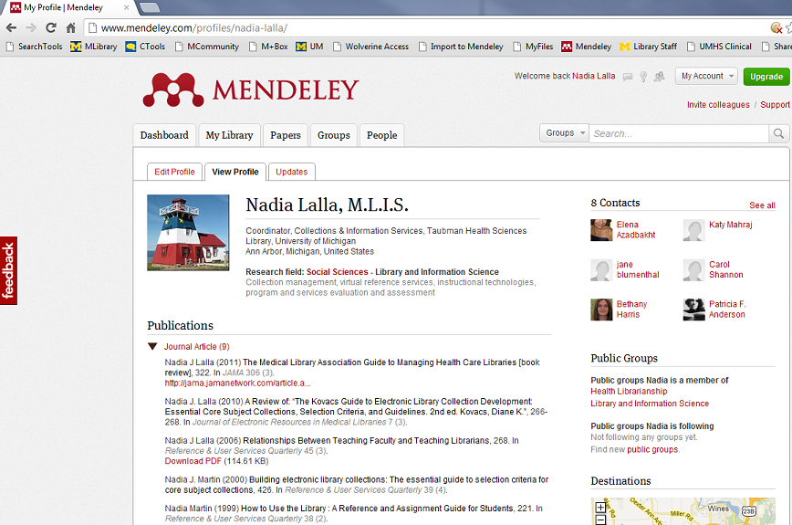
Step #3 – Add/Edit Profile: Picture, Research field, Publications, Awards and Grants, Biographical Information, CV, Contact Information

Slide 9
The Library

Slide 10
Desktop Version

Slide 11
Web Version

Slide 12
Building The Library

Slide 14
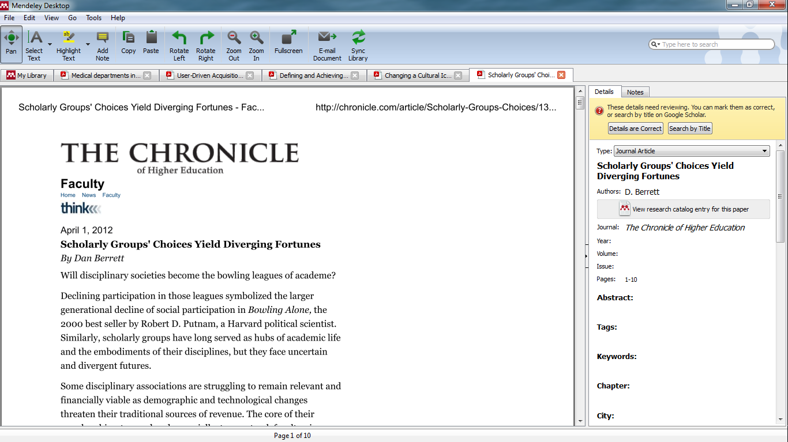
Ye Olde Drag and Drop
Missing info is added automatically

Slide 15
Building The Library:
Mendeley Web Importer

Slide 16
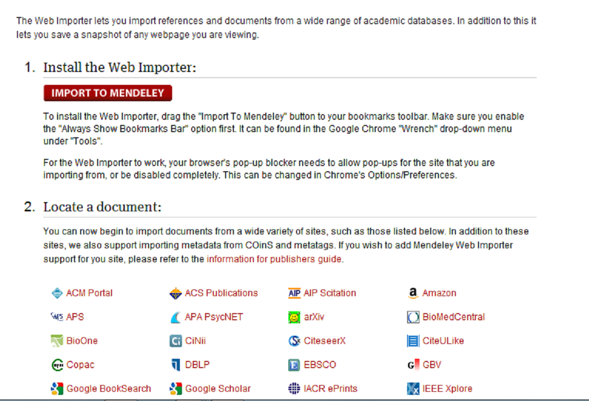
www.mendeley.com/import
To install the Web Importer, drag & drop the bookmarklet to the Favorites/Bookmarks
in web browser
Mendeley Web Importer as an extension in Chrome

Slide 17
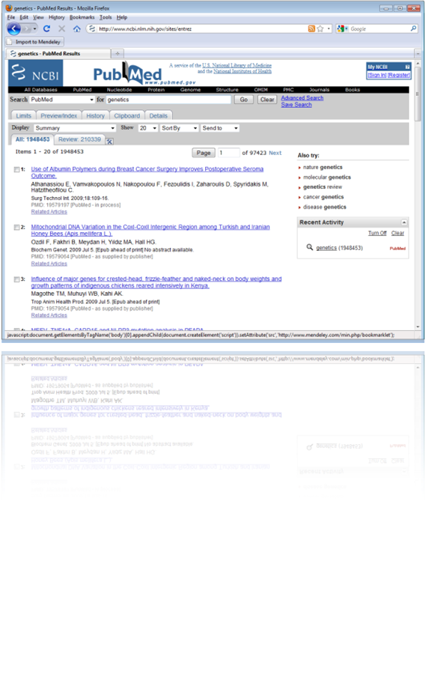
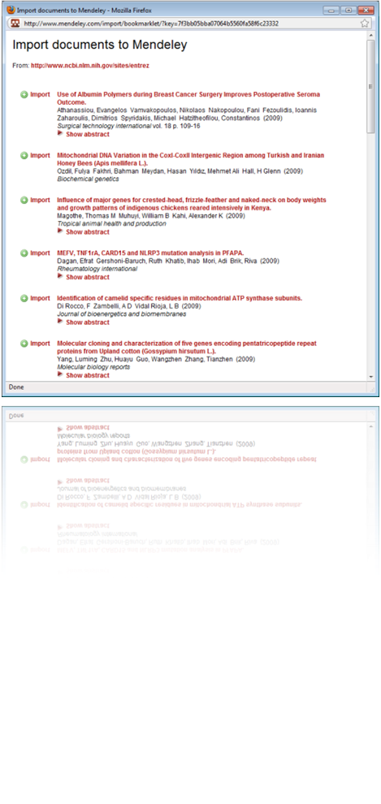
On the web page with the reference(s) you want to capture: click on the bookmarklet…
…then click on “Import” to import the reference/paper to the Mendeley library. If possible/available, also the associated PDF will be imported.

Slide 18
Building The Library:
The Mega Catalogue

Slide 19
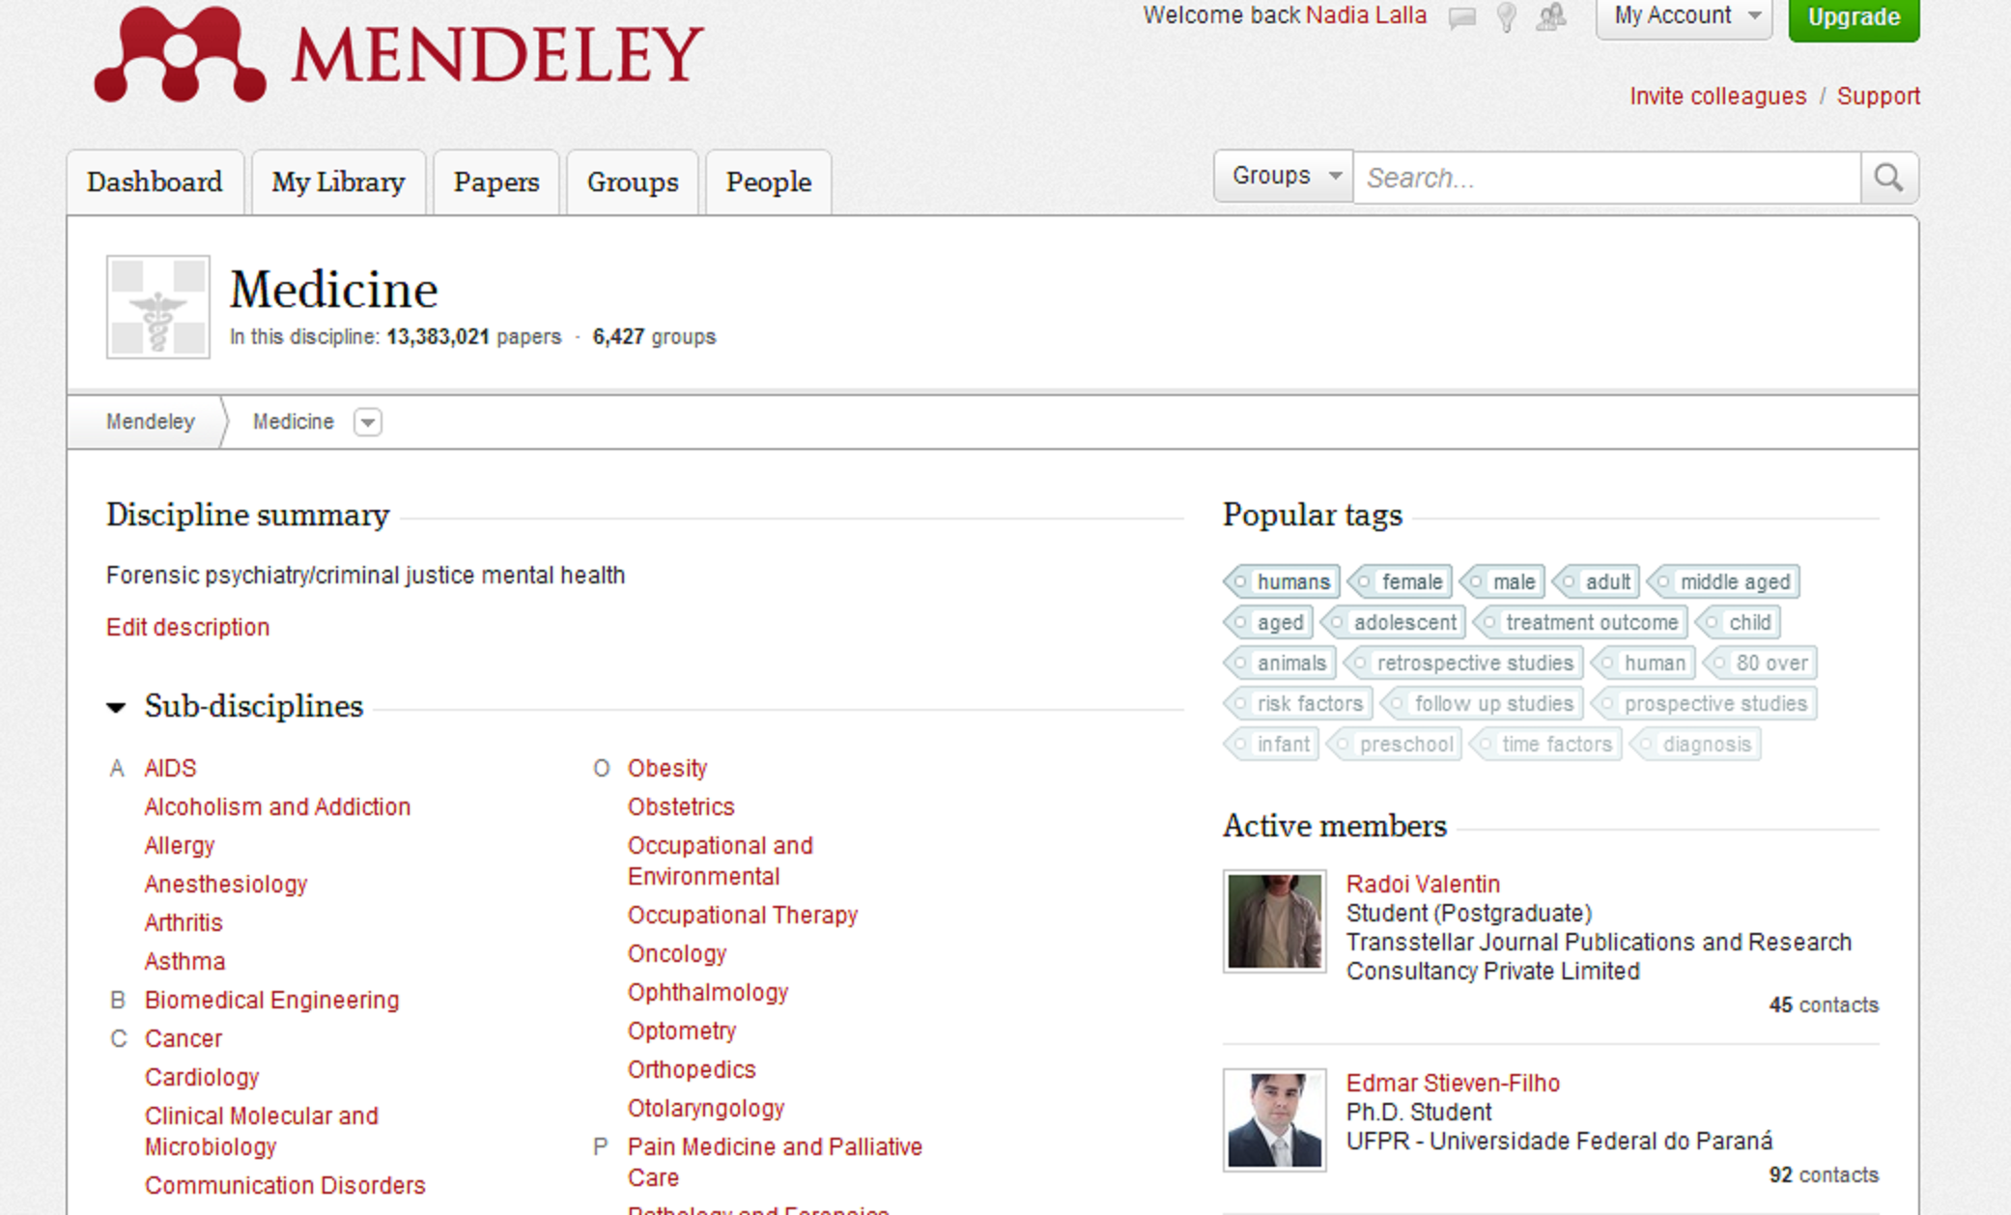
Where the really good stuff is

Slide 20
Reading and Annotating

Slide 21
Built-In Viewer

Slide 22
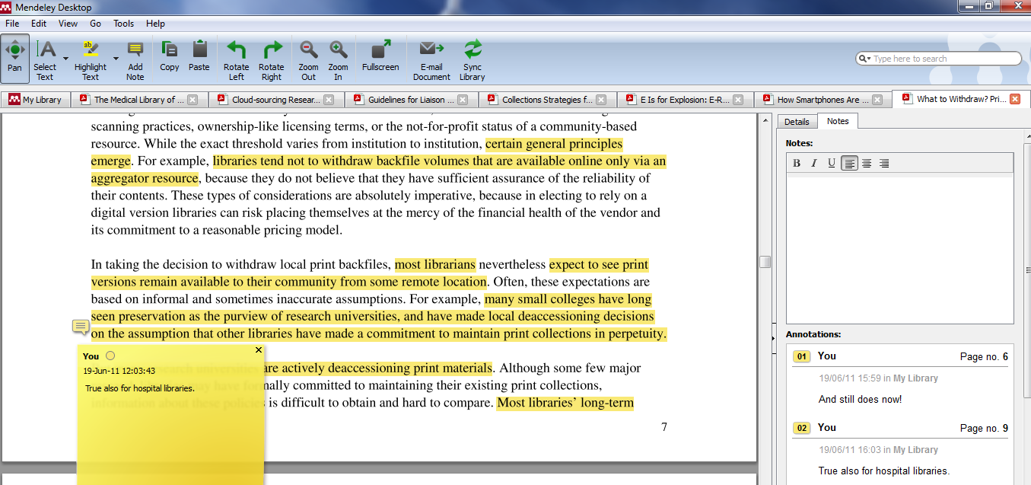
Annotations In Situ

Slide 23
Manuscript Citations

Slide 24
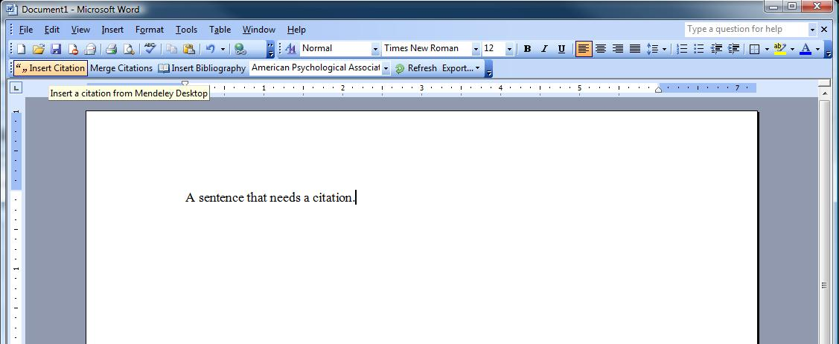
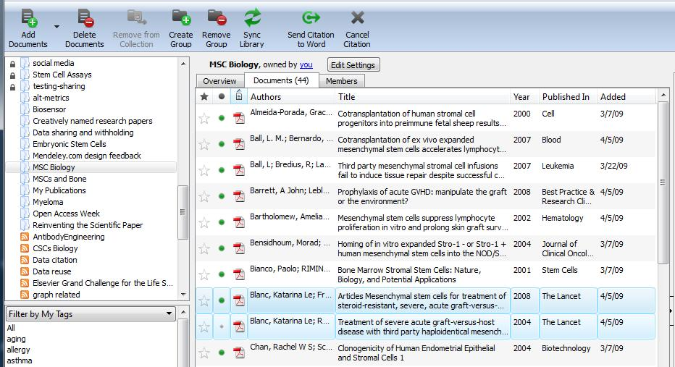
Click on “Insert Citation” in Word
Highlight the paper(s) you want to cite

Slide 25
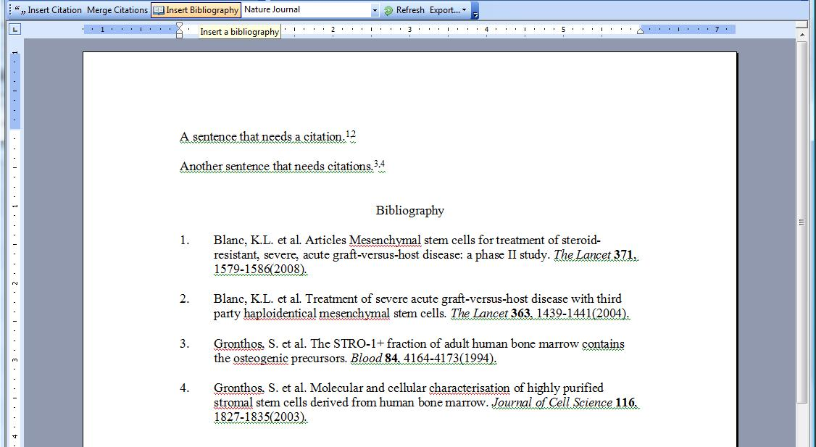
Citation will show up based on selected style
Generate a bibliography in one click
Cite into Google documents
or other editors using copy & paste

Slide 26
Collaboration

Slide 27
Join Groups and share citation
Public Groups can share citations
Private Groups can share citations and annotations and full-text
Profile = more than the basics
Crowd-sourced mega catalogue

Slide 28
Mendeley on the Go

Slide 29
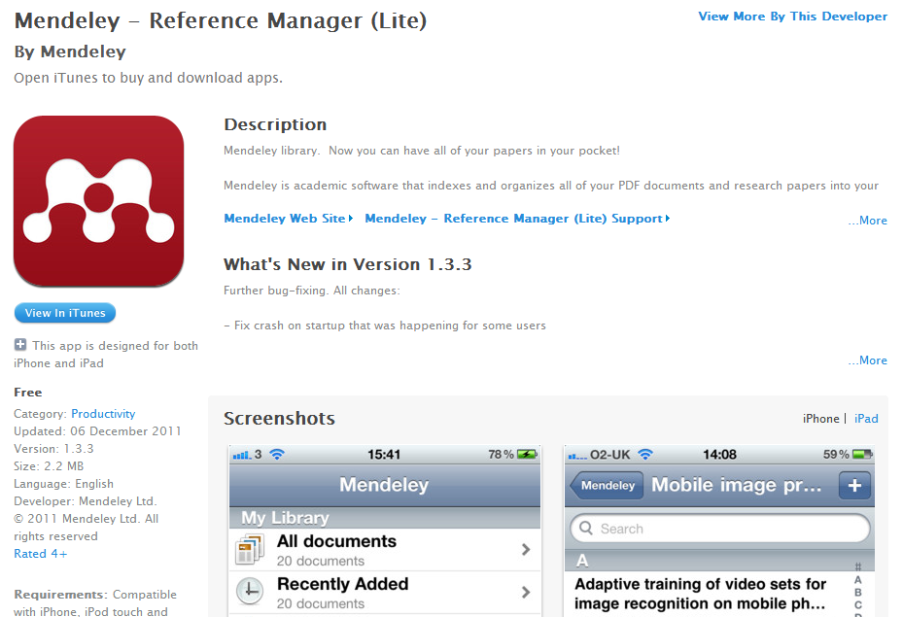

Slide 30
My Mendeley

Slide 31
Words of Wisdom
Sync the web and desktop library every time.
Use Mendeley’s organizational features to keep PDFs in one spot.
Drag and drop feature is a timesaver.
Learning curve is very gentle

Slide 32
Words of Wisdom – Part Deux
Limited publication types.
Annotations do NOT appear on iPad app.
Sync the web and desktop library every time.
Does not neatly import from some other citation management software.

Slide 33
Parting Words
Perfect for academic librarians
For clinical physicans, not as robust as Papers
If you really like it, consider upgrading to Premium level.
Sync the web and desktop library every time.

Slide 34
More Information

Slide 35
Mendeley
http://www.mendeley.com
Tutorials
http://www.mendeley.com/videos-tutorials/
Citation Styles Available in Mendeley
http://www.mendeley.com/citationstyles/
Mendeley Basics Research Guide
http://guides.lib.umich.edu/content.php?pid=119878

Slide 36
Acknowledgement

Slide 37
Slide design adapted from Mendeley’s Teaching Presentation slide deck* [no longer available online].
*Slides 4,5,16,17,24, and 25 taken entirely from above mentioned slide deck with minimal changes.

